Slide 1


Slide 2
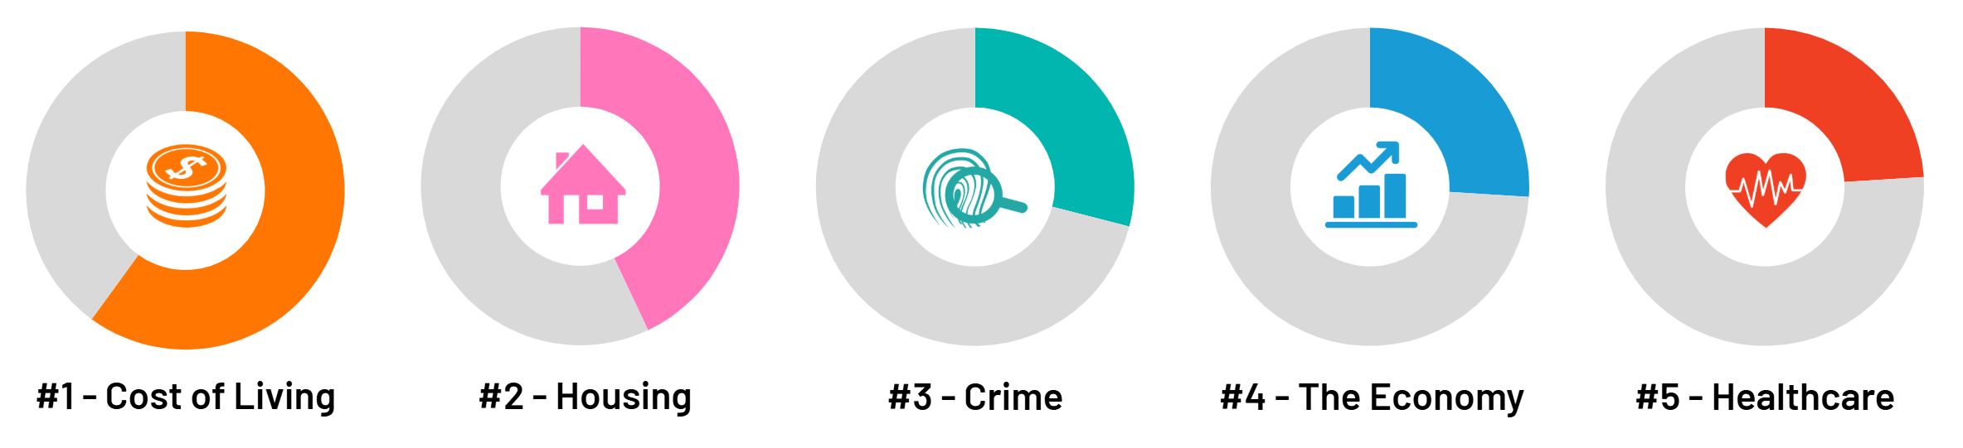


while cost of living remains a concern for Australians, there are signs of improving consumer confidence
Top 5 issues – December 2025
In 2024 and early 2025, 65% of Australians rated cost of living as their #1 issue, declining through the year
to 59% in November 2025 and 61% in December 2025.
61%
43%
29%
26%
24%
Source: The Ipsos Issues Monitor is conducted monthly via online panel. Each month approximately 1000 Australian adults aged 18+ are asked to select the top three issues facing the nation within their state and local areas from a list of nineteen potential concerns. Data is weighted to match the profile of the population.

Slide 3

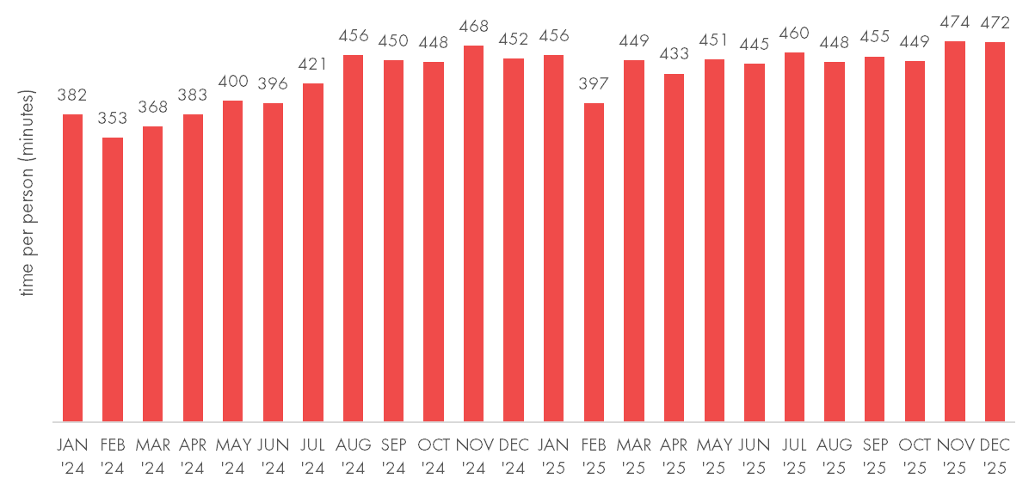
over November and December 2025, Ipsos iris recorded the highest time spent per person on retail and commerce websites and apps
retail and commerce category
average time spent (minutes) per person per month
retail & commerce
21.8 million
australians aged 14+ accessed a retail or commerce website or app in December 2025,
98.5% of all online Australians.
Click Frenzy and Black Friday in November and Cyber Monday and Boxing Day in December drove time on retail websites and apps.
Source: Ipsos iris Online Audience Measurement Service December 2025 Age 14+, computer/smartphone/tablet, audience 000s, average time per person (minutes), Retail and Commerce Category

Slide 4






nearly all online
australians visited a retail website or app in December
most popular online retail and commerce subcategories in December 2025
australian audience aged 14+
consumer electronics
18.8 million
voucher/rewards
17.7 million
grocery/supermarkets
17.3 million
21.8 million
98.5% of online australians aged 14+ visited a retail or commerce website or app on computer, smartphone or tablet in December 2025.
On average online retail visitors spent 7.9 hours on retail or commerce websites and apps in December 2025.
dept, discount stores
16.7 million
fashion & beauty
15.8 million
homes & gardens
15.0 million
Source: Ipsos iris Online Audience Measurement December 2025, Age 14+, PC/laptop/smartphone/tablet, audience (000s), audience reach, average time pp (hours), Retail and Commerce category and selected sub-categories

Slide 5

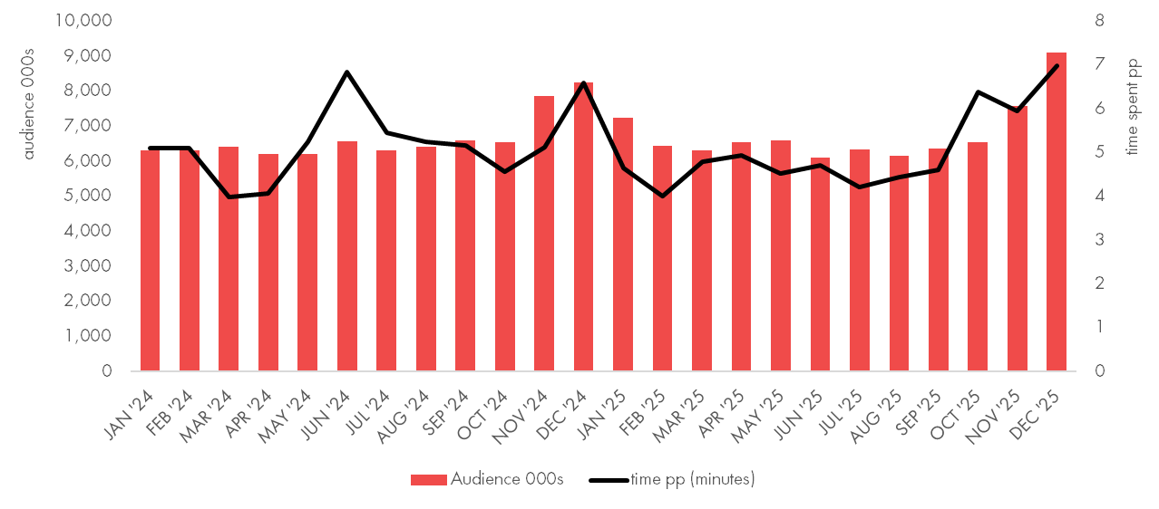
highest recorded audience to beverages retail websites and apps in December 2025
beverages retail and commerce subcategory
audience 000s and average time spent (minutes) per person per month
beverages
9.1 million
australians accessed a beverages retail website or app in December 2025,
up 10% year on year, with time spent up 6%
year on year.
Category leaders drove audience growth: Dan Murphy’s +5%, BWS +11% and Liquorland +6% Y o Y.
Source: Ipsos iris Online Audience Measurement Service December 2025 (year on year December 2024 v December 2025) Age 14+, computer/smartphone/tablet, audience 000s, average time per person (minutes), Beverages Retail and Commerce Subcategory

Slide 6
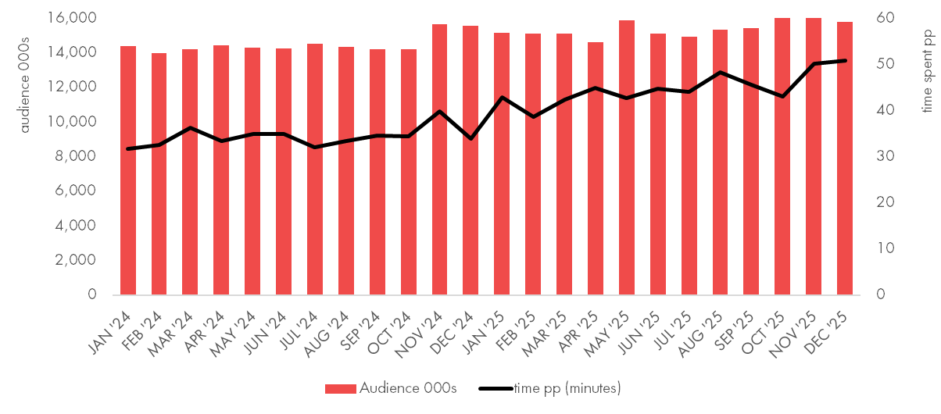
highest recorded audience to fashion and beauty retail websites and apps in November 2025 at 16.3 million
fashion & beauty, retail and commerce subcategory
audience 000s and average time spent (minutes) per person per month
fashion & beauty
15.8 million
australians accessed a fashion and beauty
retail website or app in December 2025.
Audience for online beauty peaked in December at
8.4 million, up 6%
year on year.
Av time spent on fashion & beauty websites increased 49% year on year to 51 min pp in December.
Source: Ipsos iris Online Audience Measurement Service November and December 2025 (year on year December 2024 v December 2025) Age 14+, computer/smartphone/tablet, audience 000s,
average time per person (minutes), Fashion & Beauty Retail and Commerce Subcategory

Slide 7
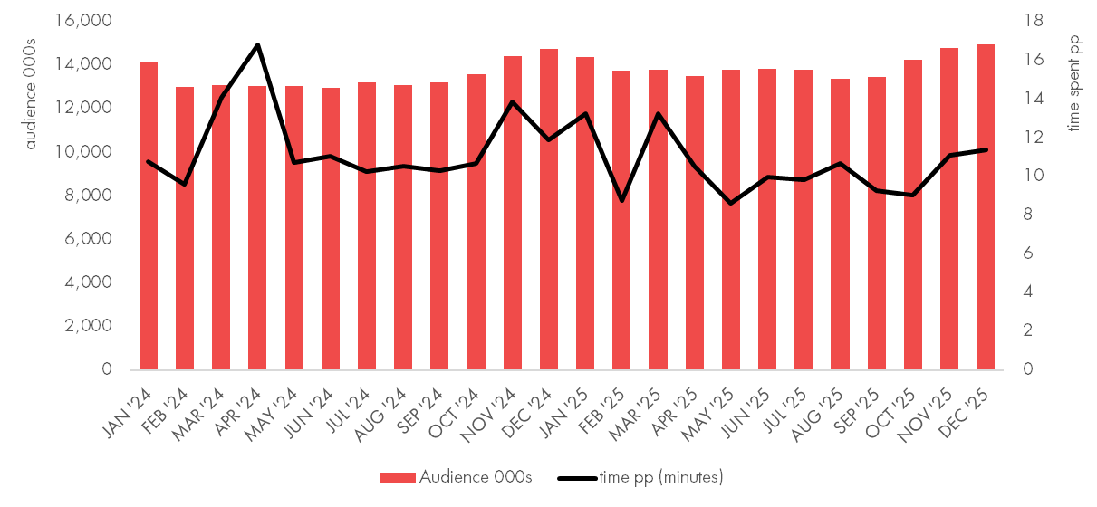
highest recorded audience to homes & garden retail websites and apps in December 2025 at nearly15 million
home and garden, retail and commerce subcategory
audience 000s and average time spent (minutes) per person per month
homes and garden
14.98 million
australians accessed a homes and garden
retail website or app in December 2025.
Category leader Bunnings Warehouse had its highest recorded audience in December at over 11 million.
Source: Ipsos iris Online Audience Measurement Service December 2025, Age 14+, computer/smartphone/tablet, audience 000s, average time per person (minutes), Homes & Garden Retail and Commerce Subcategory

Slide 8

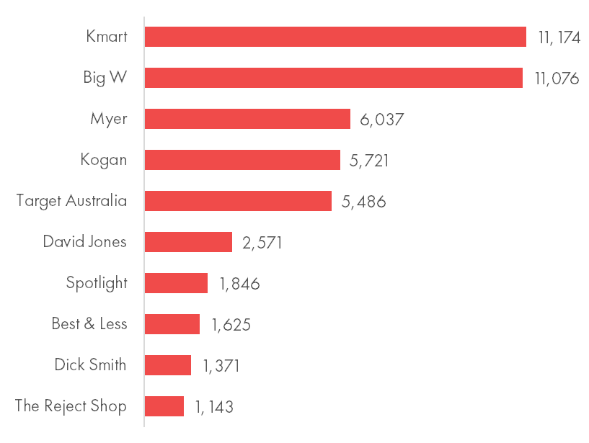
highest recorded audience to online department and discount store websites and apps in December 2025 at over 16.7 million
Top 10 Department, Discount Store or Multi-category retailer subcategory
audience 000s December 2025
Department, Discount Store or Multi-category retailer
16.7 million
australians accessed a website or app in December 2025.
Category leader Kmart increased audience 10% year on year.
Source: Ipsos iris Online Audience Measurement Service December 2025 (year on year December 2024 v December 2025), Age 14+, computer/smartphone/tablet, audience 000s, Department, Discount Store or Multi-category Retailer Retail and Commerce Subcategory

Slide 9
Ipsos iris, IAB endorsed digital audience measurement currency
Endorsed by the IAB as the sole and exclusive preferred supplier of digital audience data, Ipsos iris has been delivering market-leading insights from January 2023.
Ipsos iris serves as an inclusive, standardised industry currency, offering consistent and comparable digital audience insights for over 10,000 websites and more than 2,200 apps, capturing the online behaviours of more than 22 million Australians aged 14+ across Smartphone, Computer and Tablet devices.
Key data integrations with OzTAM for BVOD and Google for YouTube have extended the most complete view of Australians’ digital behaviour into the coverage of audiences on Connected TV to empower agencies, marketers and publishers to plan with confidence.
Ipsos iris integrates a range of data inputs to create a data set of around 500,000 synthetic respondents. Ipsos iris data inputs include on ongoing establishment survey of 12,000 per year, a single source, passive panel of 4,000 across 8,500 devices, census data from comprehensive tagging coverage of content owners and data integrations from Apple, Google and OzTAM.
Governance of Ipsos iris includes close and continuous oversight by the IAB Audience Measurement Council (made up of research professionals from 12 media owners) who regularly review KPI’s, panel health and methodology, along with data integrity, availability, delivery and usage.
Further insights and information on Ipsos iris is available in IAB Australia nickable charts and at iris-au.ipsos.com

